Slide 1
Fake News Detection using machine learning and Natural Language Processing
GUIDE: dr. Prashant kumar shukla
190031860 John wesly
190031862 Pavan kumar
190031884 Leena Sai

Slide 2
Introduction:
We are in a society where fake news spread rapidly, whoever reading the news they don’t even think whether it is fake or real they just believe in it and make others believe it blindly.
Current generation is mostly active on the social network, where the spread of fake news happens more.

Slide 3
WHAT IS FAKE NEWS?
Fake news's simple meaning is incorrect information that leads people to the wrong path.
Nowadays fake news spreading like water and people share this information without verifying it.
It is necessary to detect fake news since so many online media is using fake news as a key to earning money and spreading it far away.
The only solution to prevent fake news is fake news Detection System.

Slide 4
What is a Fake news detection system??
It is a system used to detect fake news from the given data set.
We take a data set that is heterogeneous having both fake and true news.

Slide 5
Motivation and Research findings:
Our main Motive for this project is to stop spreading fake news.
In recent times there is a lot of fake news regarding the covid-19, So we have gone through so many research papers and found some of them are useful but the none of them have a manual testing block.
The uniqueness of our project from other research papers is the data set we are using, most of the data sets used in other research papers are more focused on only one specific domain but our data set is heterogeneous data set.

Slide 6
BACKGROUND
Fake News Detection System is a process of finding the fake news among the news that we are reading on the World wide web or any other source of news.
Nowadays the spread of fake news is very fast and so many people are believing in it without any knowledge about it this fake news detections help a user to find out whether the news is fake or not.
In this project, we have used Machine learning algorithms to find out the accuracy of the data set and used the data set which got the best accuracy for manual testing.

Slide 7
DATASET DESCRIPTION and preprocessing
We got this data set from online free sources. It is an hybrid dataset which have both the true and fake news. This data set contains more than 10000 rows and 2 columns where the two columns are “headlines” and “outcome”.
Headline column is having all the news headlines as data and Outcome column has “0” and “1” where 0 means the news is a Fake news and 1 means the news is Real news.
This data set doesn’t have any unwanted features so we didn’t need to do any feature extraction and we have clean the raw data for that we have to do text pre-processing and remove all the unwanted terms or symbols so that an ML Algorithm can understand the data easily.

Slide 8
NLP (Natural Language Processing)
Natural Language Processing is an area of artificial intelligence that allows machines to read, understand, and interpret human languages.
In NLP the raw text is collected tokenized and vectorized and then apply ML Algorithm.

Slide 9
Raw Text: Collecting Data from the Available Sources.
Tokenization: Here we do Data Pre-processing where we remove null space and replace it with empty space. And also removing unwanted columns.
Text Cleaning: After Data pre-processing, we do text pre-processing, where we clear the special characters and some other alphabets like “ ” ’s \ ? / [ ] () {} @ # etc. By making this we can simplify data for vectorization.
Tf-idf Vectorizer: Term Frequency-Inverse Document Frequency
This is a method for determining the number of words in a collection of documents. Each word in the document and corpus is given a score to indicate its relevance. In information retrieval and text mining, this method is commonly utilized.

Slide 10
ML Algorithm:
For vectorized data set we apply ML Algorithm for getting accuracy for data set. Here we used ML Algorithms like Boosting Techniques, And Ensemble learners (Decision Tree, Random Forest, Logistic Regression, Linear SVM, KNN Algorithm).

Slide 11
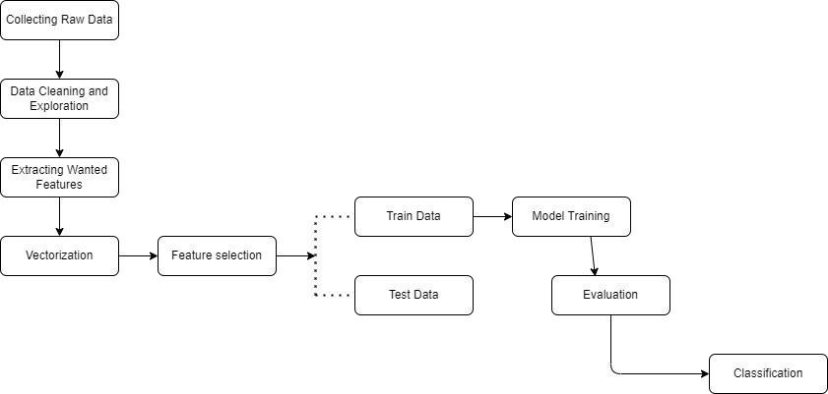
Flow chart

Slide 12
At First, we have to collect the Raw data from the Open sources and we have to explore the features of data and clean the data.
We have extracted the wanted features and merged them for the selection process.
We have to select the merged features and drop the remaining features of the data set.
We have to split the following dataset into Test and Train data sets.
We have to train the data and use the Machine learning algorithms for finding the accuracy of the dataset.
After finding the accuracy of data we have to classify the data and use it for Manual testing.
In manual testing the user will give random data as input and our project will find the data among the available data set and classify whether the given data is Fake or Not.

Slide 13
Result Discussion:
After data per processing we implement machine learning algorithms and boosting techniques to get an accuracy of a data set.
Logistic Regression OUTPUT: Accuracy of Logistic Regression model is 0.9983230855226384
Decision Tree OUTPUT: Accuracy of Decision Tree model is 0.9994410285075461
Random Forest Classifier OUTPUT: Accuracy of Random Forest Classifier model is 0.9994410285075461
K Nearest Neighbour OUTPUT: Accuracy of K Nearest Neighbour model is 0.9586361095584125

Slide 14
SIGMOD KERNEL OUTPUT: Accuracy of SVM model is 0.9665551839464883
MLP mode ADABoost + Linear SVM OUTPUT: Accuracy of MLP model is 0.939453350247953 →ADABoost + Linear SVM ADABOOST with SVM Output: Accuracy of ADABOOST with SVM model is 0.9610194902548725
MANUAL TESTING Output: NOT A FAKE NEWS

Slide 15
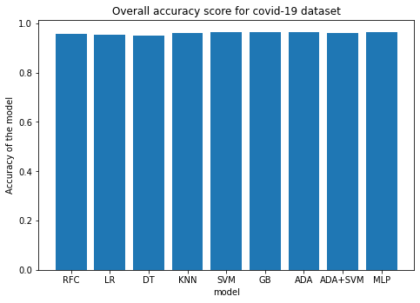
ACCURACY OF EACH MODEL
Overall Accuracy score for Covid-19 Dataset
S/No | Model | Accuracy
1. | Random Forest | 0.962
2. | Logistic Regression | 0.953
3. | Decision Tree | 0.943
4. | KNN Classifier | 0.963
5. | SVM | 0.964
6. | Gradient Boosting | 0.939
7. | ADA Boosting | 0.939
8. | ADA+SVM | 0.966
9. | MLP | 0.939

Slide 16
conclusion
In this project we had added ADABOOST and Linear SVM ang got better accuracy.
As a future generation of the present society it is our responsibility to make sure that only the Real news should spread across as now a days lots of fake news is spreading rapidly than the real news it is our part to show the news is fake or not, for that this is our part of idea which can be improved more. As our part of idea have the predefined dataset which is used for manual testing where user gives an input of the news and check whether the input is Real news or the fake news.

Slide 17
Thank you

